Slide 1


Understanding
Shares & Equity
Claiming your slice of the multi-billion dollar pie.

Slide 2

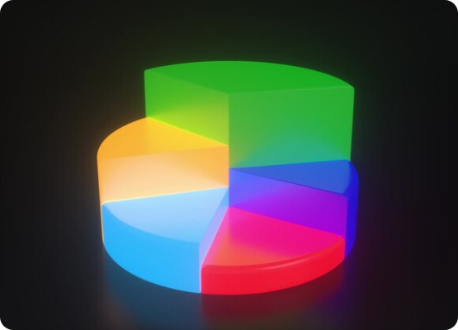
What is Equity?
Imagine a massive, delicious pizza. The entire pizza represents the total value of a company.
The Concept: Equity is simply a fancy word for "Ownership". When you buy equity, you are buying a slice of that corporate pizza.
Shareholders: By owning a slice (a share), you become a part-owner of the company. You legally own a fraction of its assets and future profits.
Risk & Reward: If the pizza gets bigger (company grows), your slice is worth more. If the pizza burns in the oven, you lose money.

Slide 3


Types of Shares
Common Shares (Equity)
Preference Shares
This is what 99% of retail investors buy and trade on the stock exchange every single day.
These are a special hybrid instrument, usually bought by large institutions, HNI (High Net-worth Individuals), and venture capitalists.
Common shares give you the highest potential for growth and profits, but they also place you at the bottom of the ladder if the company goes bankrupt.
They act a bit like a stock and a bit like a bond, offering a fixed, predictable return but sacrificing aggressive growth.

Slide 4







Inside Common Shares
High Risk, High Reward
Variable Dividends
The Power to Vote
If the company makes massive profits, your stock price skyrockets. But if it fails, common shareholders are the very last to get their money back.
The company is not legally obligated to pay you a dividend. The board of directors decides if, when, and how much dividend to distribute from profits.
Because you hold all the risk, you hold the power. Common shares come with voting rights on major corporate decisions.

Slide 5

Inside Preference Shares
Fixed Dividend Guarantee
Unlike common shares, preference shareholders are promised a fixed dividend rate (e.g., 8% per year), regardless of whether the company makes a small profit or a huge one.
Priority in Liquidation
If the company goes bankrupt and shuts down, preference shareholders get their money back *before* any common shareholders get a single rupee.
No Voting Rights
Because they are protected from the extreme risks, they surrender their right to vote on company matters. They are silent financial backers.

Slide 6

The Power of
Voting Rights
When you own common shares, you aren't just a spectator; you are an active participant in corporate democracy.
Every year, companies hold an AGM (Annual General Meeting). As a shareholder, you get to vote on crucial issues.
What do you vote on? Electing the Board of Directors, approving mergers or acquisitions, passing the dividend payout, and deciding on executive salaries.

Slide 7
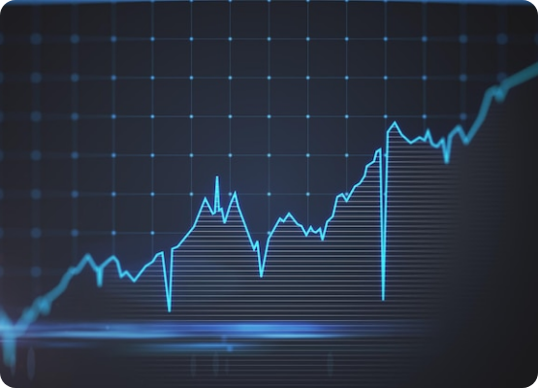
Market Capitalization
Market Capitalization (or Market Cap) is the total "price tag" of the entire company in the stock market.
If you wanted to buy 100% of the company right now from every single shareholder, the Market Cap is the amount of money you would need.
We use this number to categorize companies into different tiers of risk and growth.

Slide 8


The Giants: Large Cap
Ranked 1 to 100
These are the top 100 largest companies listed on the exchange by market capitalization (e.g., Reliance, TCS, HDFC Bank).
The Pros: They are extremely stable, well-established, and often pay consistent dividends. They are the safest equity investments during market crashes.
The Cons: Because they are already massive, their room for hyper-growth is limited. Don't expect your money to double overnight.

Slide 9


The Sweet Spot: Mid Cap
Ranked 101 to 250
The Balancing Act
These are medium-sized companies that have successfully moved past their startup phase and are expanding aggressively.
Mid-caps offer the perfect balance for many investors.
They provide significantly higher growth potential than Large Caps, but they are less volatile and risky than Small Caps. They are tomorrow's potential industry leaders.
Think of them as teenagers in the corporate world—they have a lot of energy and are growing fast, but can sometimes be a bit unpredictable.

Slide 10

The Wild West: Small Cap
High Risk, High Reward
These are the companies ranked 251st and below. They are relatively young, niche, or regional businesses.
251+
The Opportunity: A successful small cap has the potential to multiply your money 10x or 50x over a decade if it becomes the next big thing.
MARKET RANK
The Danger: They are highly volatile. During market crashes, small caps fall the hardest, and many struggle to survive tough economic times.

Slide 11
Great Job on Day 4!
Tomorrow: Stock Market Ecosystem.
Don't forget to Like, Share, and Subscribe!
/ @EarnJoyOfficial

